Slide 1
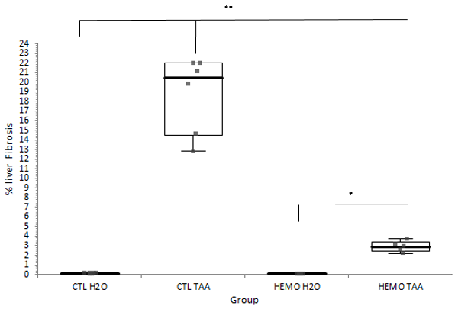
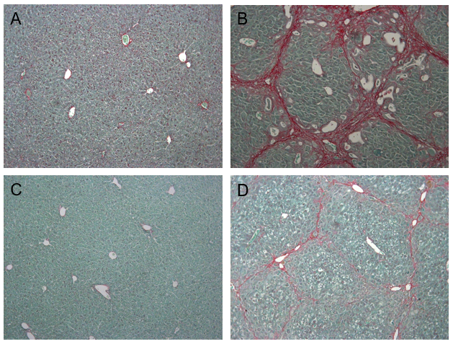
Does hemophilia slow down the development of liver fibrosis?
M.A. VAN DIEVOET ¹, I. LECLERCQ ¹, C. HERMANS ¹, C. LAMBERT ¹, Y. HORSMANS ¹, M. JACQUEMIN ² and S. EECKHOUDT ¹
1Cliniques universitaires Saint-Luc, Brussels, Belgium
2Universitair ziekenhuis Leuven, Leuven, Belgium
Contact information: Marie-Astrid van Dievoet, Cliniques Universitaires Saint-Luc, +3227643700, marieastridvandievoet@hotmail.com.
Introduction
Up until 1989, when hepatitis C virus (HCV) was discovered and viral inactivating procedures were developed, almost all patients treated with clotting factor products were infected by HCV. Unexpectedly, the liver complications of HCV are less severe in subjects with hemophilia A than in other patients.
Methods
Fig. 1: Thioacetamide (TAA) intake over a two-month period in HEMO-TAA) and CTL-TAA mice.
Liver fibrosis was induced by thioacetamide (TAA) in Factor VIII-deficient mice (HEMO) and normal controls (CTL; Fig. 1), while control groups received only water (H2O).
After 25 weeks, the mice were sacrificed and liver biopsies were taken for the evaluation of fibrosis:
collagen Type I messenger ribonucleic acid (mRNA) was measured by quantitative PCR
collagen deposition was quantified by staining with PicroSirius red
AIM
We investigated whether hemophilia A protects from liver fibrosis in a murine model of chemically-induced liver cirrhosis.
Results
Significant fibrosis developed in all TAA-treated mice.
In CTL-TAA mice, thicker and more complete bundles of collagen intersected the liver, than in HEMO-TAA livers (Fig. 2).
Hemophilia mice treated with TAA developed a significantly lower level of fibrosis than the CTL-TAA group (p <0.01, Fig. 3).
The amount of Type I collagen mRNA, described as an early event in the development of liver fibrosis, caused by activation of hepatic stellate cells [1], was higher in CTL-TAA groups than in the HEMO-TAA (p <0.05).
Fig.3. Liver fibrosis. To quantify collagen deposition in the liver, picro-sirius red stained sections were scanned using a Leica scanner. Morphometric analysis was by analyzing a minimum of 5 fields per slide. Percentage of liver fibrosis was expressed as the ratio of picro-sirius red stained area to the total area (**p-value <0.01; * p-value <0.05).
Fig.2. Collagen staining of liver sections. A = CTL-H2O, B = CTL-TAA, C = HEMO-H2O, D = HEMO-TAA group.
Several studies support the hypothesis that the protective effect hemophilia offers against liver fibrosis progression may be accounted for by reduced thrombin generation [2;3].
Thrombin may contribute to liver cirrhosis by activating hepatic stellate cells (HSCs) and platelets via the protease-activated receptor (PAR) pathway. The activated stellate cells may switch into a myofibroblast phenotype, causing enhanced production of extracellular matrix (ECM) and collagen deposition in the liver, eventually resulting in liver fibrosis.
Conclusions
Our study demonstrates that hemophilia A has a protective effect against liver fibrosis development.
To the best of our knowledge, this is the first work that demonstrates in an animal model that hemophilia A protects the liver against cirrhosis progression.
References
1 Stefanovic B et al. Posttranscriptional regulation of collagen a1(I) mRNA in hepatic stellate cells. Mol Cell Biol 1997;17:5201-9.
2 AnsteeAnstee QM, Goldin RD, Wright M, et al. Coagulation status modulates murine hepatic fibrogenesis: implications for the development of novel therapies. J. Thromb. Haemost. 2008; 6: 1336-43.
3 Vilaseca M et al. The anticoagulant rivaroxaban lowers portal hypertension in cirrhotic rats mainly by deactivating hepatic stellate cells. Hepatology 2017,65:2031-44.
Acknowledgements
The authors stated that they had no interests which might be perceived as posing a conflict or bias.

